Slide 1
Rapid Micro Methods PPAR 2013
Jeffrey W. Weber, PAT Project Manager
Kalamazoo, MI
Oct 2013
Notes:
Abstract: Process Analytical Technology has become recognized as an important set of tools to improve pharmaceutical and laboratory
operations. Rapid Microbiological Methods (RMM) will be presented including the development of novel technologies that solve real world
business problems and create value to organizations. This presentation provides an introduction to RMMs, review of systems, and
approaches for the application to environmental monitoring and troubleshooting using RMM systems.
Purpose of presentation: To serve as a the starting point for the development of future state of micro testing. Currently we perform discrete testing and do not use the results effectively across the manufacturing cycle. This is amplified by micro testing as the tests are rather slow and provide results retrospectively.
Audience: Process engineers, regulatory agency senior management, and vendors.

Slide 2
Biologics II: RMM
Rapid micro-biologic testing
- Success stories: in-line TOC, etc..
Value, gaps, and roadblocks
- RMM testing and continuous mfg

Slide 3
Rapid Micro Methods are ~ 5 years behind PAT systems. J Weber
Opportunity to take lessons learned and apply to RMM arena.
Unfortunately consultants are reaping the benefits ($)
Lack of guidance and understanding

Slide 4
USP <1117>
“It should be noted that microbiology is a scientifically based discipline that deals with biological principles substantially different from those of analytical chemistry and engineering disciplines. Many times it is difficult for individuals without specific microbiological training to make the transition.”

Slide 5
PPAR Survey

Slide 6
PPAR Survey
what is the biggest gap for RMM systems?
Staffing
Environmental Monitoring

Slide 7
Current Micro Lab Testing

Slide 8
Who owns RMMs?
RMM
Manufacturing (PAT)
QC (Micro Labs)
In-plant testing
Raw materials screening
Process decisions
EMA / EP support
Lean labs
More automation
Less “micro” training
USP / FDA aligned
Is this an opportunity to align micro with PAT and engineering?
Notes:
There is a difference in the implementation of the systems and the use of the results based on the system owner. As indicated, the PAT areas use the results to adjust the process rather than regulatory release. The Labs (QC) see RMMs as a tool to remove bottlenecks and improve the flow through the laboratories.

Slide 9
Current Micro Testing
Discrete point sampling
EM
Raw Materials
Personnel
Sterility testing
Limited temporal information
Retrospective
“all or nothing”
Silos
Raw
Materials
Process / Plant
People
Product
Patient
Notes:
Growth based – slow
Limited by compendial requirements, often a “red herring” to limit the systems to the current state of testing.

Slide 10
Future Micro Testing
Continuous monitoring
Holistic control
Raw material characterization is part of process
Extreme temporal information
Infinite sublots
Real Time Release Testing (parametric release)
Raw
Materials
Process / Plant
People
Product
Intelligence-based Manufacturing (IbM)
Patient
Notes:
The future of micro testing is incorporated into the manufacturing cycle similar to PAT or other engineering controls. The measurement systems and results are used to control the process.

Slide 11
Future RMM Platforms
Enhanced COA data
Raw
Materials
Automated plate reader
Process / Plant
Aerosol cytometry
Personnel Automated Sampler
People
Product
Liquid Bioburden
Intelligence-based Manufacturing (IbM)
Automated Water Testing
Online Water BioBurden
Enhanced LIMS / SPC /
Cpk - MVDA
Patient
Notes:
The future platforms will serve the largest micro testing loads: environmental monitoring 85%, water testing 10%, product 4%, and other 1%. The product may be the most value added from cost / return testing, the EM testing offers the biggest volume and overhead reductions.

Slide 12
Model Implementations
Online Total Organic Carbon for Water
Minimal regulatory impact to online testing
Improved process control over grab samples
No guidance from USP, EP or JP initially for use of online testing
ASTM guidance E2656-10
Companies have moved to RTRt water release
Business benefit
Notes:
The online TOC should be used as the model for online bioburden and endotoxin systems rather than waiting for the compendia or Agencies to develop guidance that may limit flexibility. There was no previous guidance for the move from laboratory sampling to online TOC and it was driven by the qualified utilities groups cost savings and improved process understanding.

Slide 13
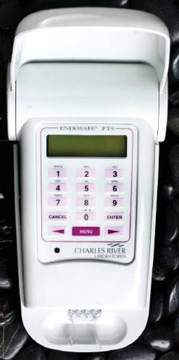
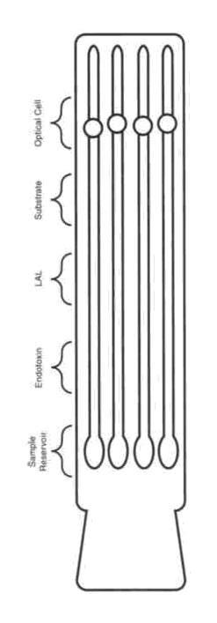
Successful Platforms
Technology: Chromogenic Limulus amoebocyte lysate, or LAL assay. USP <85> and EP 2.6.14 Method D. A simplified and rapid endotoxin testing method.
Recommended Applications
Compendial endotoxin testing
Development studies
In-process testing
System Roles
Water testing (routine and post-maintenance)
Buffer hold times
Cleaning verification
Endotoxin removal efficiency
Final Product testing
Notes:
Very successful implementation of the CRL EndoSafe was completed within Pfizer as the system offered a reduced testing workload, compendial equivalence, and portability.
Enables “on-demand” testing.

Slide 14
RMM Challenges
RMM systems are orthogonal to compendial testing
Different units
CFU versus BioCounts
How to react to new information?
Regulatory requirement (i.e. heavy metals)
Product Quality
Interaction with Regulatory Agencies
Notes:
Orthogonal testing to current platforms. How do we move to completely different metrics for product control and quality?
There are issues with new platforms that provide newer or more sensitive results. Next slide provides illustration.

Slide 15
Industry Perspectives
Pfizer would like to see the development
Online Water Testing
At-line bioburden
BioBurden Testing
Simplified testing
Online Endotoxin
Environmental Monitoring

Slide 16
Questions?

Slide 17
Traditional Micro Challenges
Classic culture assay is less than perfect!
10⁶
Microorganisms
Limitation of Growth Media
10³
Culturable
Microorganisms
1 gram sample or 100 mL water
1
Sampling
Limitations
Risk Analysis
http://www.enviroliteracy.org/article.php/58.html
Notes:
The current testing that the RMMs are measured against are not great, but are validated. Moving towards a risk-based analysis.
There is definitely a difference between regulatory requirement versus process capability

